Slide 1
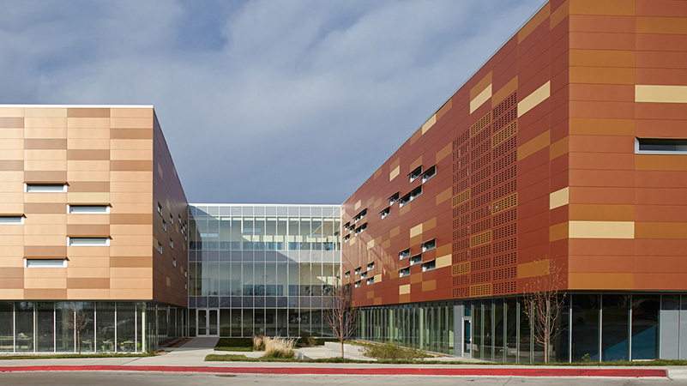
Olweus Bullying-Prevention Program (OBPP)

Slide 2
http://www.youtube.com/watch?v=h5yg0u1MkDI

Slide 3
Quick Review

Slide 4
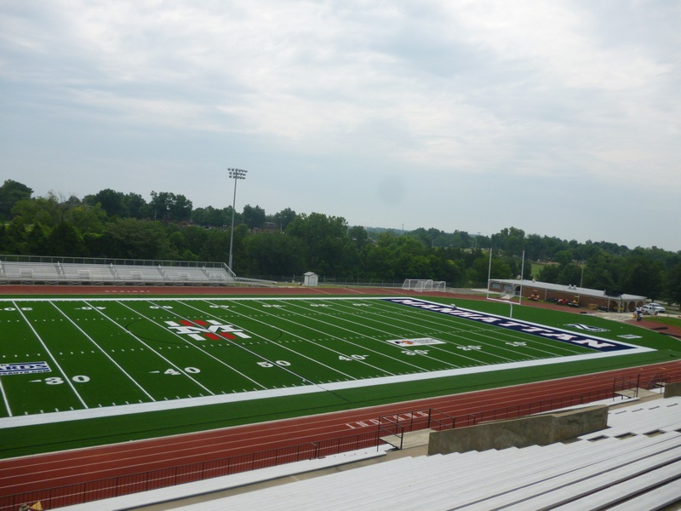
Quick Review
Olweus Kick-off
in
January

Slide 5
Preparation
August 12: Staff Training
September 13: Goals
September 19: Principles
October 3: Rules and Reporting
October 10: Bullying Hot Spots at MHS
October 24: Class Meetings

Slide 6
MHS Olweus Website
http://mhsolweus.weebly.com/plt-staff-discussions---west.html

Slide 7
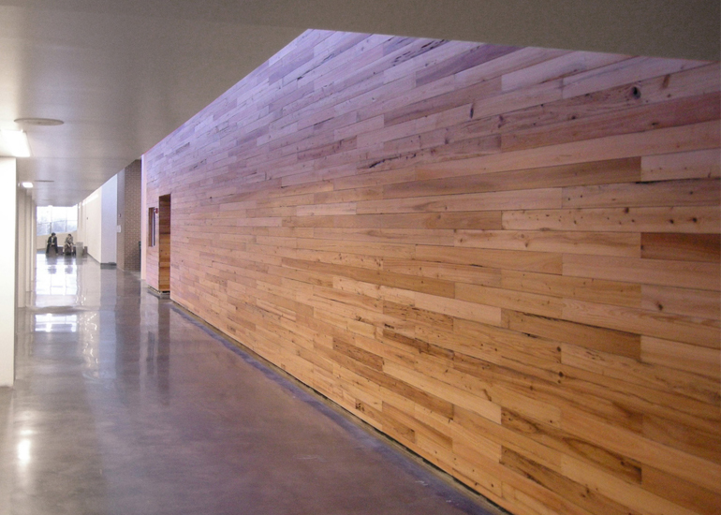
class meetings

Slide 8
WHEN?
Meetings will begin in January—
after the kick-off.
We’ll hold them regularly—
probably twice a month.

Slide 9
WHO?
Teachers → facilitation
Students → ownership
Committee → support
Administrators → direction

Slide 10
WHAT?
The first few meetings will be scripted, focusing on our school-wide OBPP.
Subsequent meetings may cover other issues (climate, communication, etc.).

Slide 11
WHY?
Here are the main goals of class meetings:
1. to build class cohesion and community;
2. to teach the four anti-bullying rules;
3. to encourage students to consider the consequences of bullying; and
4. to help students identify strategies to address bullying issues.

Slide 12
HOW?
Scripts and lessons
Outlines
General objectives
Sample activities
Committee
Administrators

Slide 13
Summary: Class Meetings
Hold meetings consistently.
Create a safe environment.
Encourage student ownership.
Facilitate discussions.
Rely on available resources.
What questions do you have?

Slide 14
Feedback Form
jf
Thanks!
Taylor Mali: What Do Teachers Make?
“I make a difference. How about you?”

